Slide 1
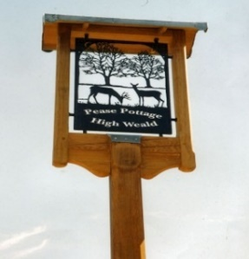
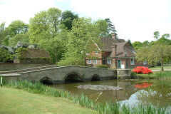
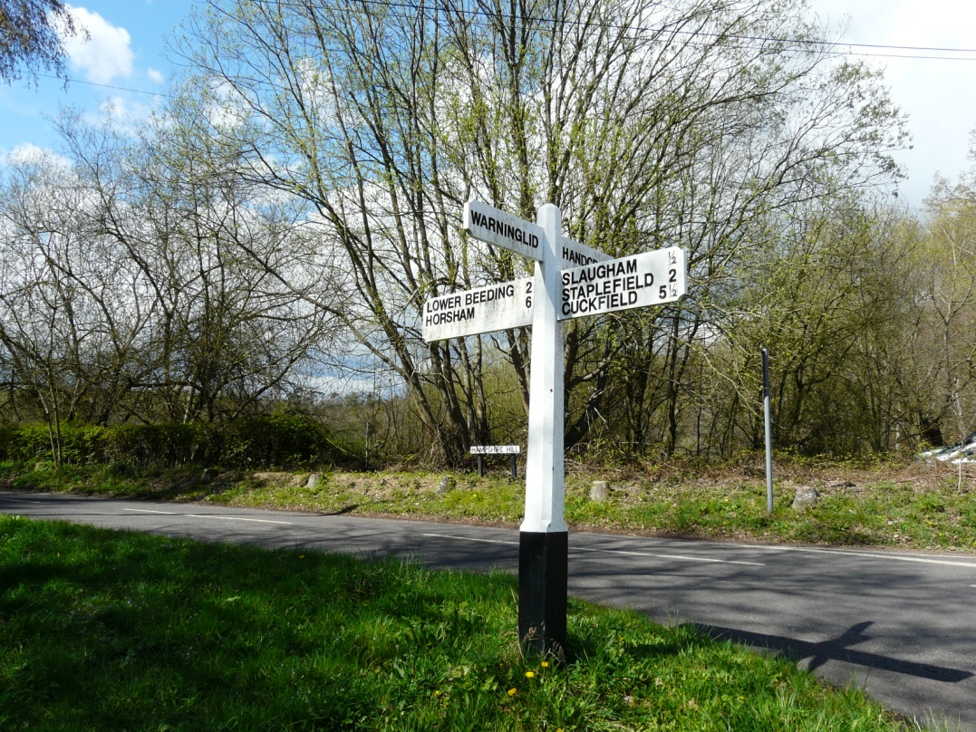
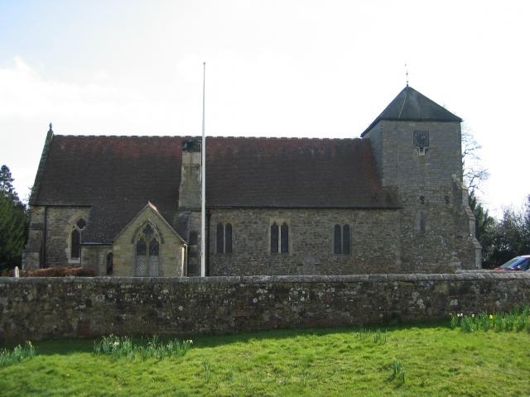

Slaugham Parish Neighbourhood Plan Site Exhibitions
Villages of Handcross, Slaugham, Warninglid & Pease Pottage
Dear Resident
The Slaugham Parish Neighbourhood Plan Group will be running two public exhibitions:-
Friday 7th April 2017 6.00pm – 9.00pm
Saturday 8th 2017 10.00am-2.00pm
These will be held at the
The Sports Pavilion, Recreation Ground, High Street, Handcross
If you are not familiar with the aim of the plan, its intention is to establish a vision of the future of the parish and to set out how that vision will be realised through planning and controlling land use and development change. Specifically, the plan proposes how much new housing should be built in the parish up to 2031 and where this housing should be built. It also makes proposals for specific sites for other land uses..
The Slaugham Parish Neighbourhood Development Plan is being prepared in accordance with the Town & Country Planning Act 1990, Planning & Compulsory Purchase Act 2004, Localism Act 2011 and Neighbourhood Planning (General) Regulations.

